Slide 1
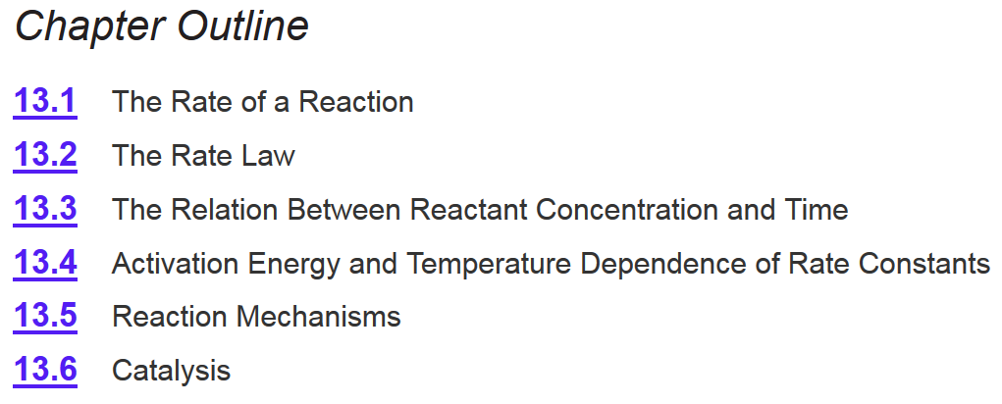
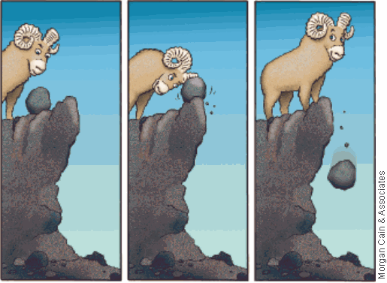
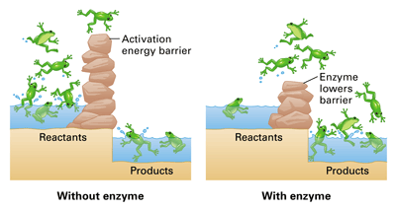
Chapter 13
Ch 13
Page 564

Slide 2
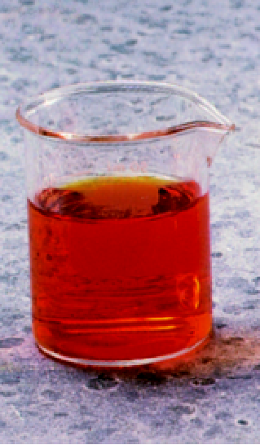
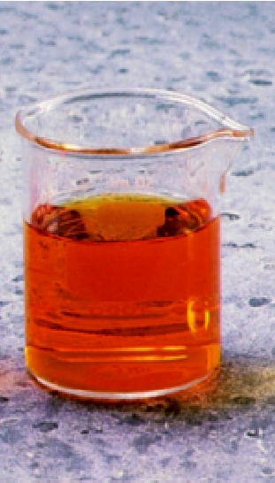
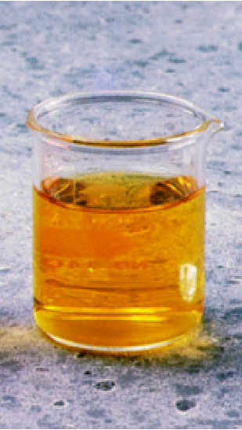
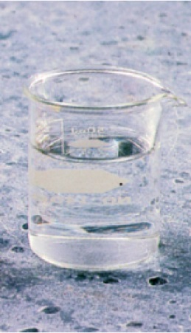
Chemical Reactions
A ⎯→ B
Δ[A]
rate = -
Δt
rate = k [A]
ln[A]_{t} = -k • t + ln[A]₀
Process Dynamics
Abstract concept (orange to clear)
Molecules
  Have a size and shape.
  Have distributions of kinetic energy

Slide 3
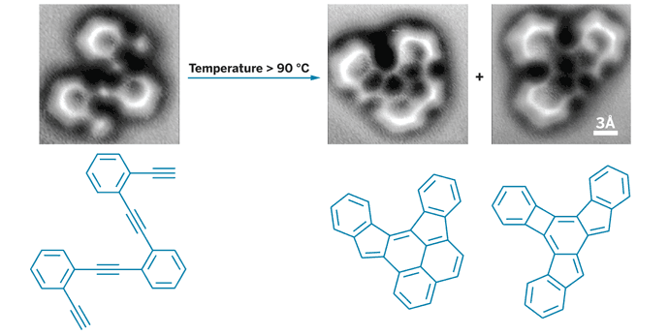
“Seeing” a Reaction
http://www.sciencemag.org/content/340/6139/1434
2A ⎯→ B + C
Nature of the molecules
Intermolecular interactions
Activation energy (Temp)
Orientation

Slide 4
Collision theory of reaction rates
Three basic events must take place for the reaction to occur
The atoms, molecules, or ions must:
  collide
  collide with enough energy to break and form bonds
  collide with the proper orientation for the reaction to take place
These events depend on the concentrations of reactants, as well as on the temperature.
Ch 13.4
Page 590

Slide 5
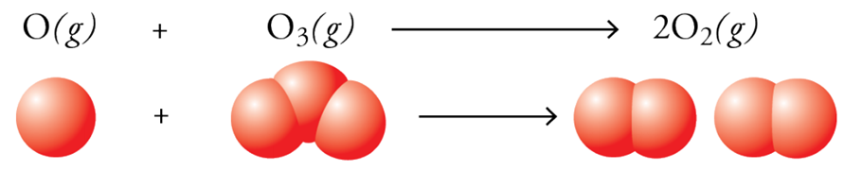
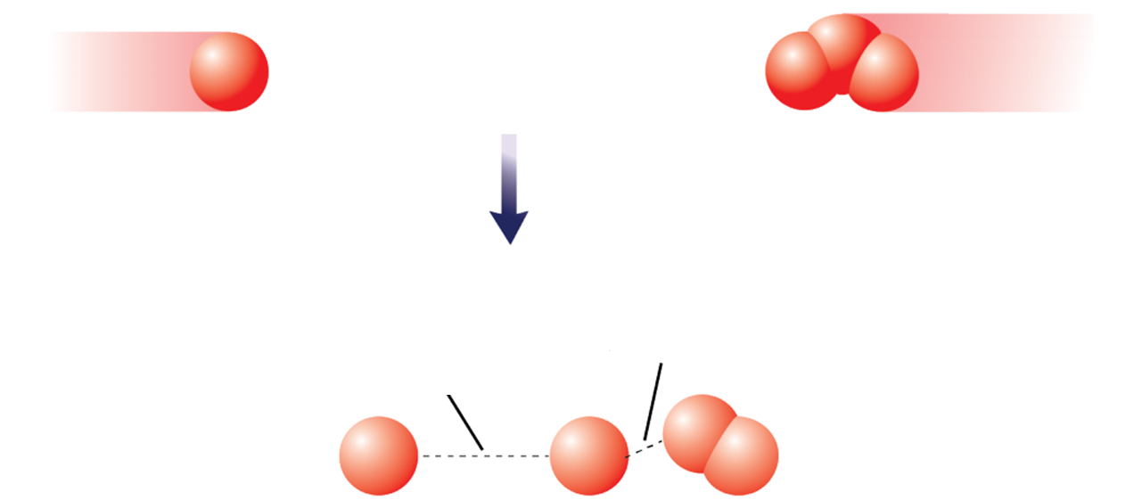
Collision theory of reaction rates
1) Molecules Must Collide
2) Have enough energy to make and break bonds
O and O₃ collide
Bond making (releases energy)
Bond breaking (requires energy)
3) Have the correct orientation to react.

Slide 6
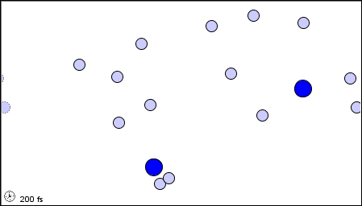
Collision theory of reaction rates
1) Molecules Must Collide
A + B ⎯→ 2C

Slide 7
Collision theory of reaction rates
1) Molecules Must Collide
A + B ⎯→ 2C
2A + 2B
  4 interactions
The number of collisions is proportional to the number of molecules, that are able to collide.
This explains the concentration dependence of the rate law:
3A + 2B
  6 interactions
4A + 2B
  8 interactions
2 x [A] = 2 x collisions = 2 x rate

Slide 8
Collision theory of reaction rates
1) Molecules Must Collide (concentration dependence)
2) Have enough energy to make and break bonds
O and O₃ collide
Collisions alone do not guarantee a reaction!
Bond making (releases energy)
Bond breaking (requires energy)
3) Have the correct orientation to react.

Slide 9
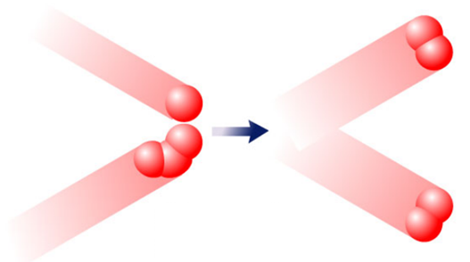
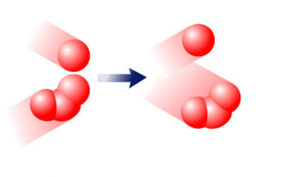
Collision theory of reaction rates
2) Have enough energy to make and break bonds
O and O₃ collide
Bond making (releases energy)
Bond breaking (requires energy)
Energy to break bonds comes from kinetic energy.
Kinetic energy → Vibration energy
kinetic energy
activation energy
kinetic energy
activation energy
<
>

Slide 10
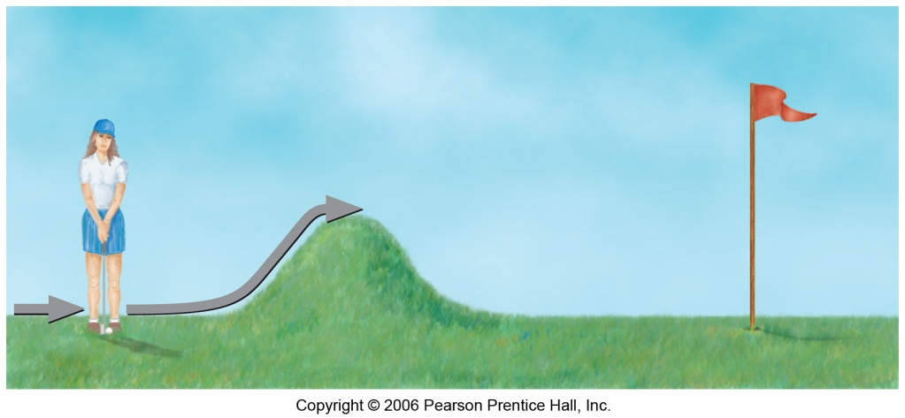
Collision theory of reaction rates
Activation energy (E_{a})- the minimum energy that must be overcome for the reaction to occur.
Just as a ball cannot get over a hill if it does not roll up the hill with enough energy, a reaction cannot occur unless the molecules possess sufficient energy to get over the activation energy barrier.
Ch 13.4
Page 591

Slide 11
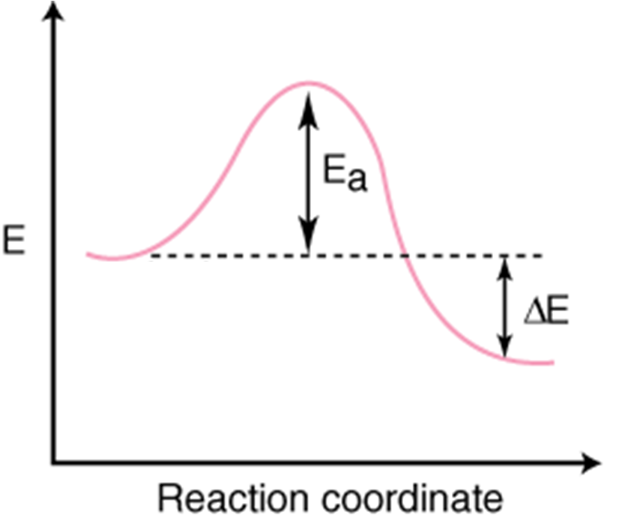
Reaction Coordinate Diagram
A + B ⎯→ 2C
Activation Energy
Need to add energy to the system
Energy is released
A + B
Thermodynamic driving force
2C
Energy of the Reactants
Energy of the Product
Progress of the reaction

Slide 12
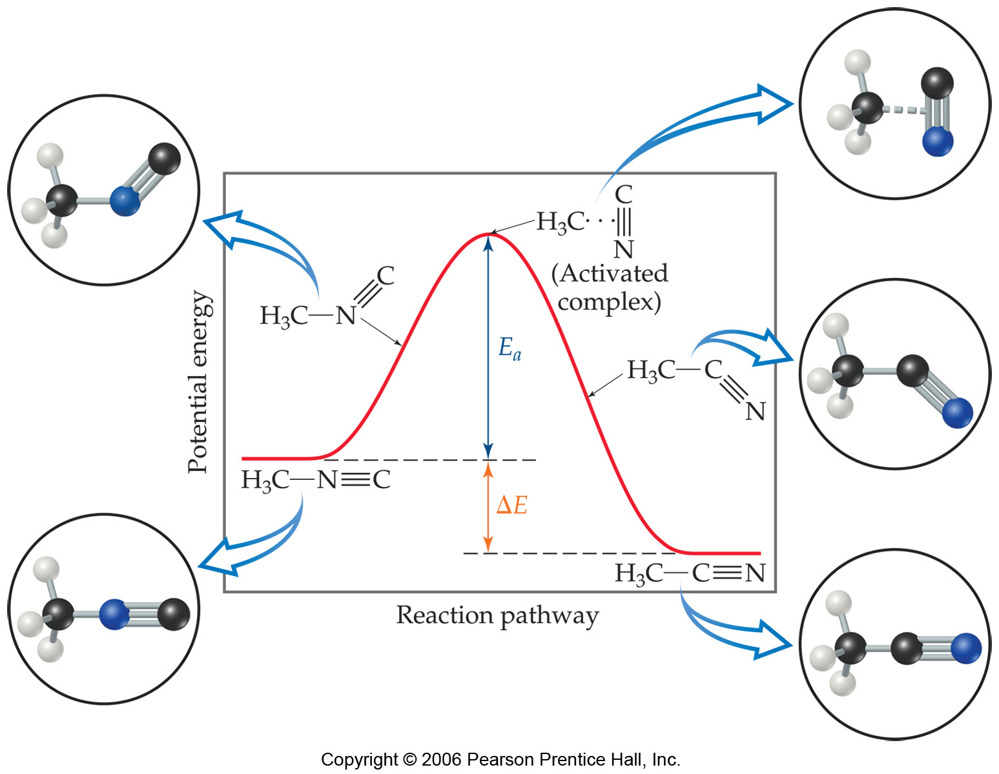
Reaction Coordinate Diagram
H₃CNC ⎯→ H₃CCN

Slide 13
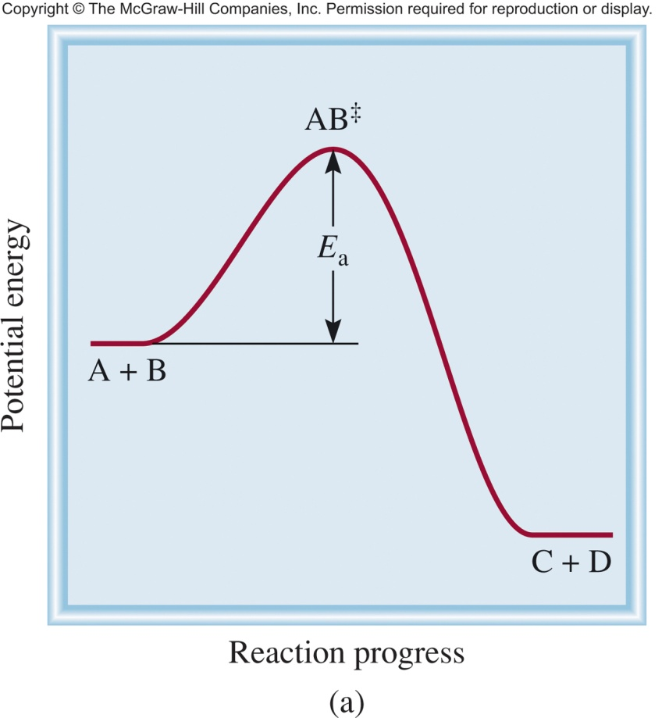
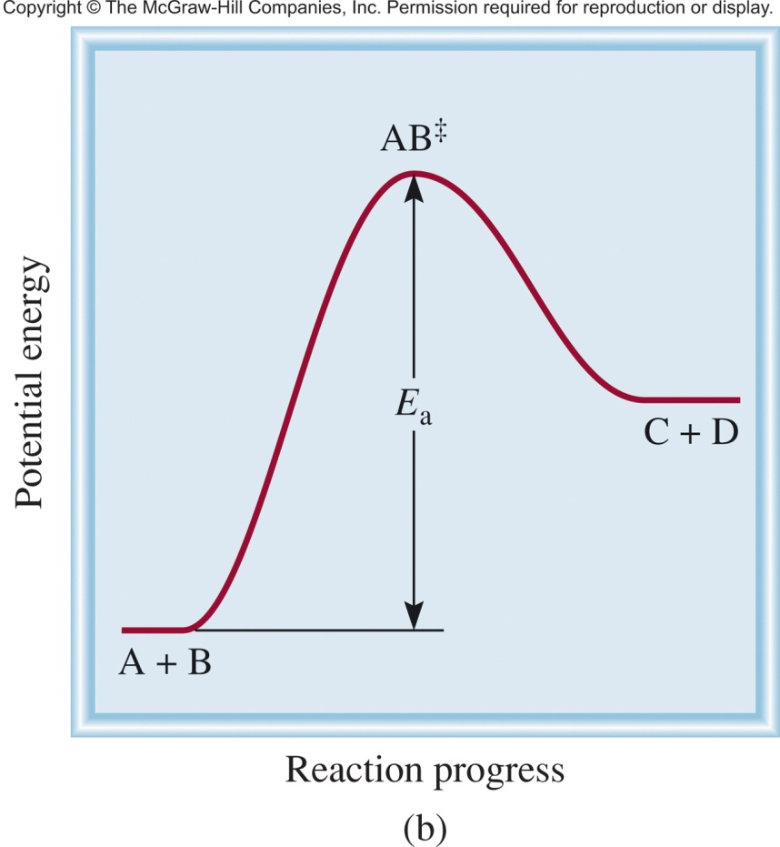
Reaction Coordinate Diagram
Exothermic Reaction
Endothermic Reaction
Energy_{products} < Energy_{reactants}
Energy_{products} > Energy_{reactants}

Slide 14
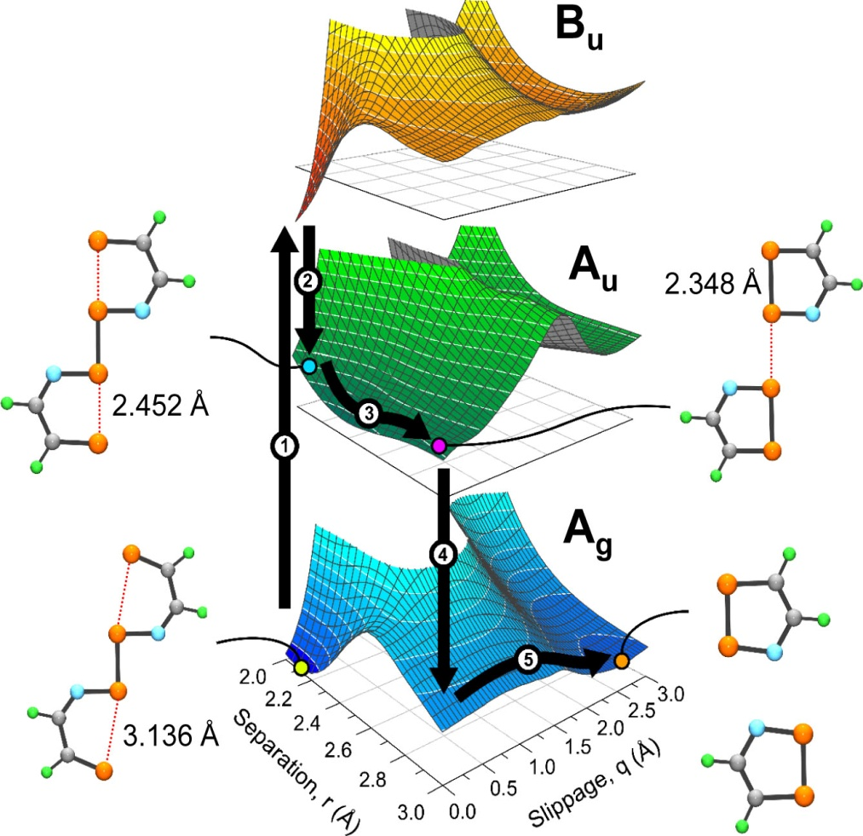
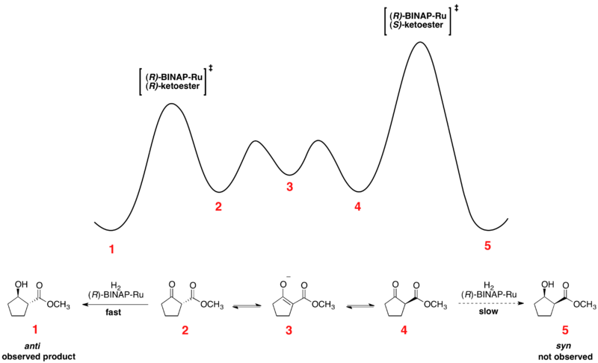
Reaction Coordinate Diagram
They get fun/complex!

Slide 15
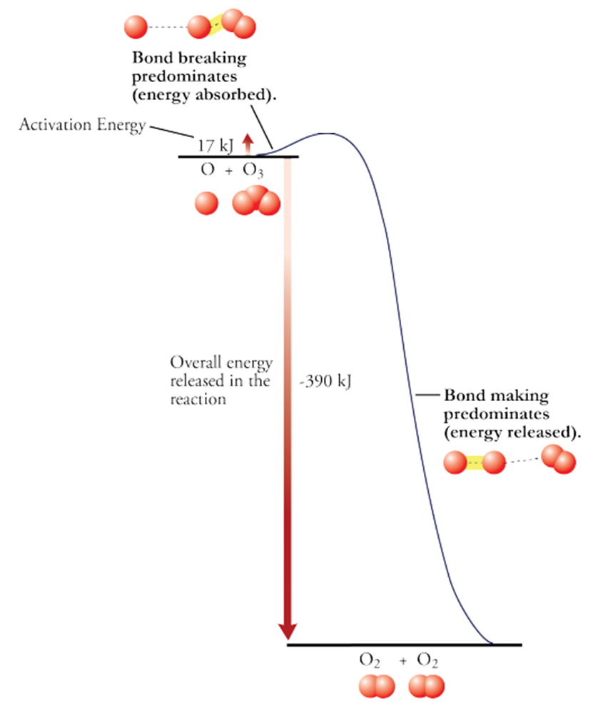

Collision theory of reaction rates
2) Have enough energy to make and break bonds
O and O₃ collide
Bond making (releases energy)
Bond breaking (requires energy)
Kinetic energy → Vibration energy

Slide 16
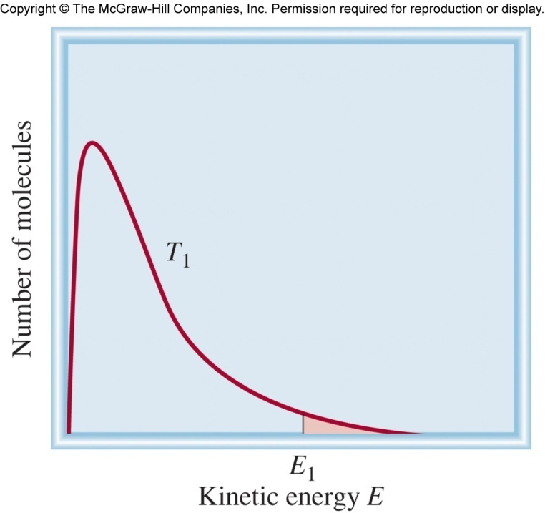
Collision theory of reaction rates
Kinetic energy → Vibration energy
“slow” molecules
“fast” molecules
Average kinetic energy ∝ Temperature
Average kinetic energy ∝ Reaction rate
Reaction rate is temperature dependent!

Slide 17
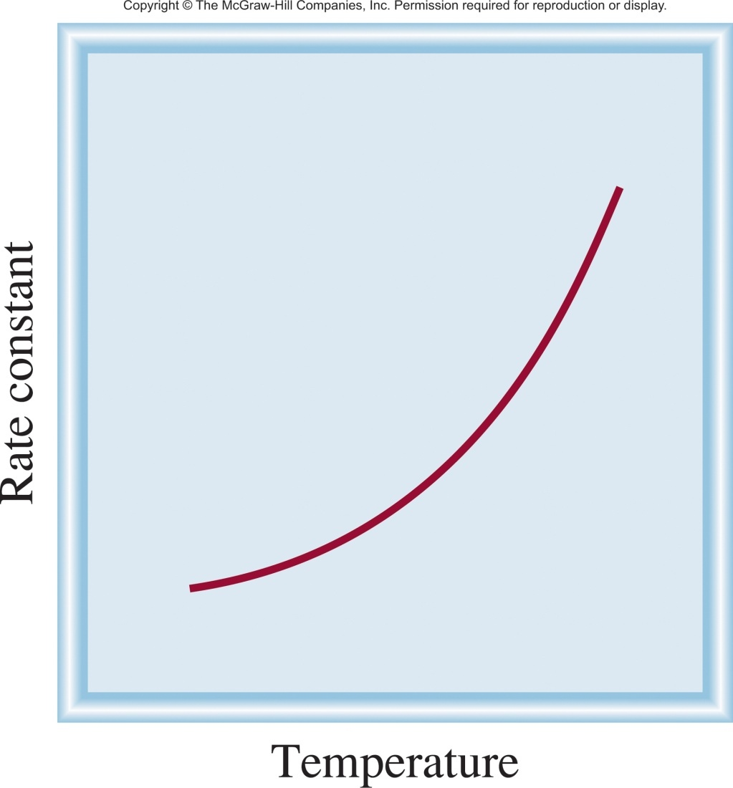
Reaction Rate and Temperature
Average kinetic energy ∝ Temperature
Average kinetic energy ∝ Reaction rate
Reaction rate is temperature dependent!

Slide 18
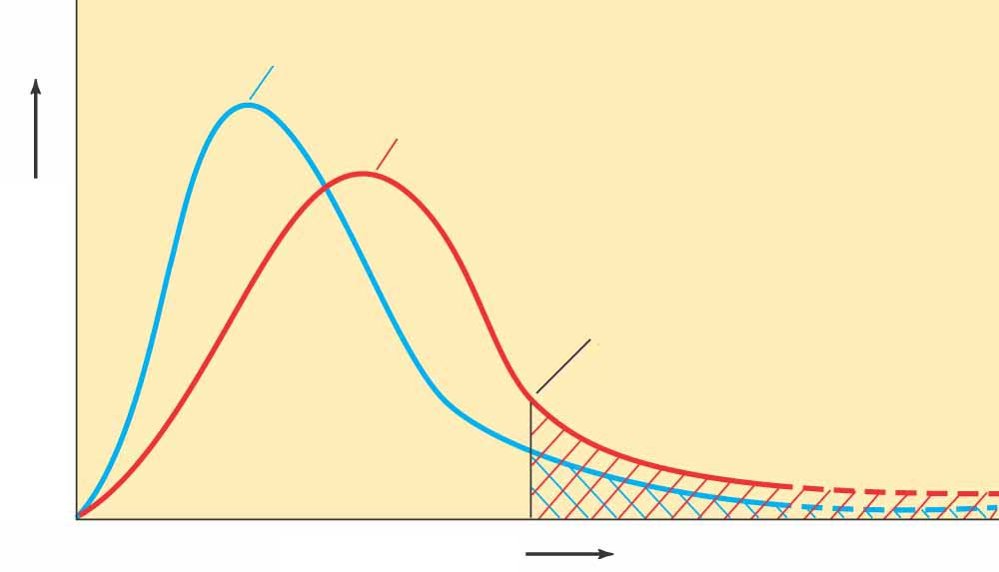
Collisions and Temperature
Kinetic energy → Vibration energy
The reaction rate increases with temperature because:
  The particles collide more frequently.
  More particles possess enough energy to overcome the activation energy and react.
The second of these effects is much more important!
Only those collisions with enough energy can lead to the chemical reaction.
  Lower temperature
  Higher temperature
  Fraction with enough energy to react
  # of molecules
  Kinetic Energy
Ch 13.4
Page 591
Arrhenius equation

Slide 19
Arrhenius Equation
E_{a} is the activation energy (J/mol)
R is the gas constant (8.314 J/K•mol)
T is the absolute temperature (K)
A is the frequency factor
(~collision frequency)
Temperature
Rate constant
Reaction rate
Activation energy
Rate constant
Reaction rate

Slide 20
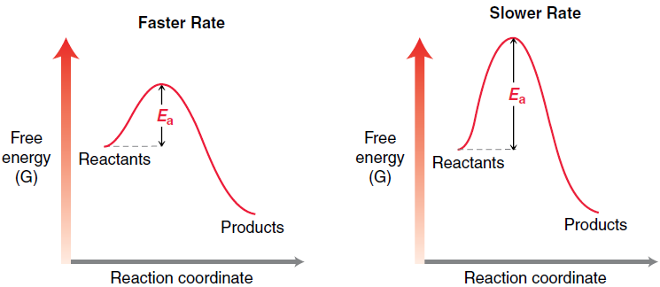
Quick Question
If both are heated to the same temperature, which reaction is faster?
A
B

Slide 21
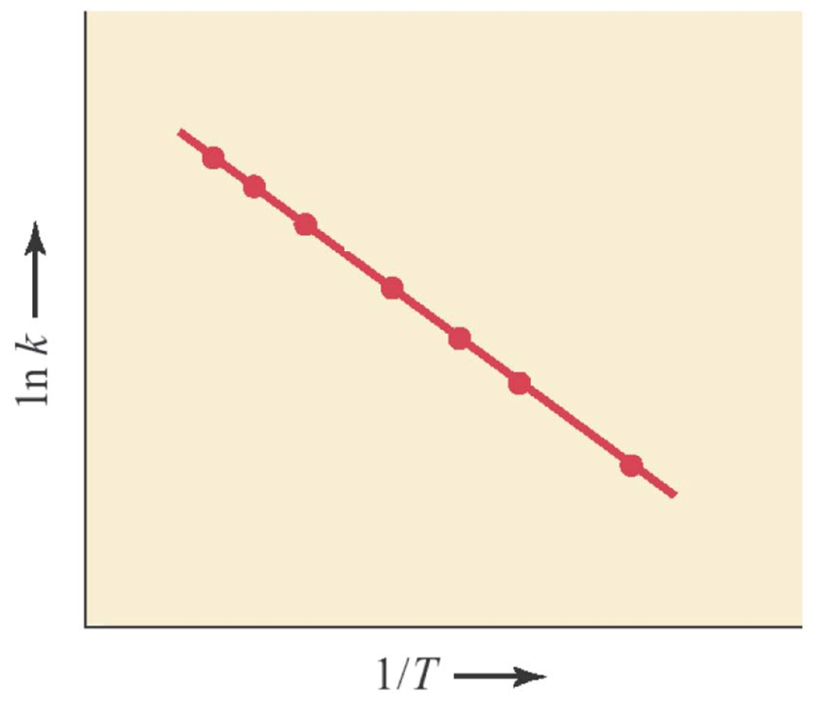
Arrhenius Equation
y = m • x + b
E_{a}
1
ln k = -
•
+ ln A
R
T
The activation energy can be determined by plotting the natural log of the rate constant vs. the inverse temperature.

Slide 22
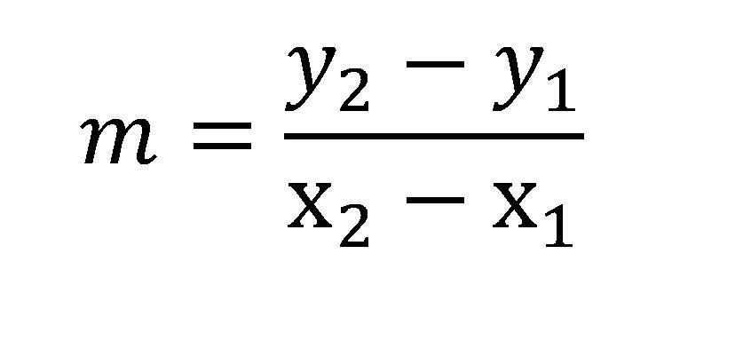
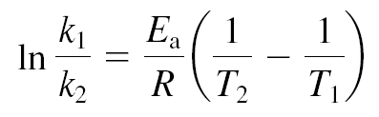
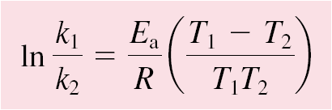
Arrhenius Equation
Alternate Forms of the Arrhenius Equation
Slope = change in y/the change in x
or
If we know E_{a} and k₁ at one temperature we can predict k₂ at another T.

Slide 23
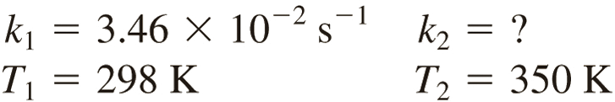
13.9
The rate constant of a first-order reaction is 3.46 × 10⁻² s⁻¹ at 298 K.
What is the rate constant at 350 K if the activation energy for the reaction is 50.2 kJ/mol?
E_{a} = 50.2 kJ/mol

Slide 24
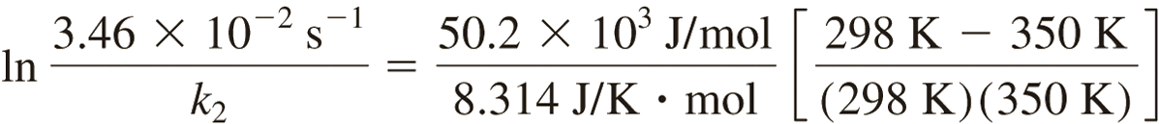
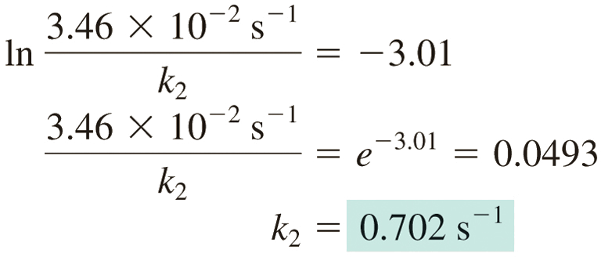
13.9
Solution The data are
Substituting:
E_{a} = 50.2 kJ/mol

Slide 25
Collision theory of reaction rates
1) Molecules Must Collide (concentration dependence)
2) Have enough energy to make and break bonds
O and O₃ collide
Collisions + energy alone do not guarantee a reaction!
Bond making (releases energy)
Bond breaking (requires energy)
3) Have the correct orientation to react.

Slide 26

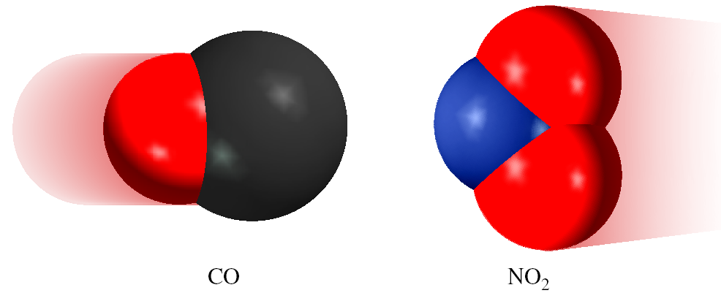
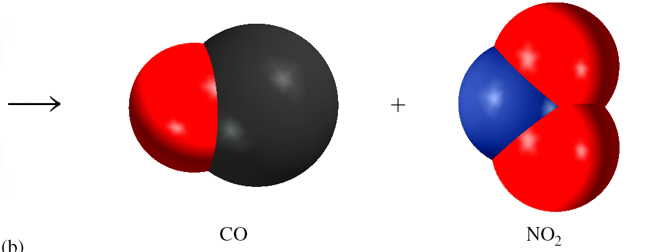
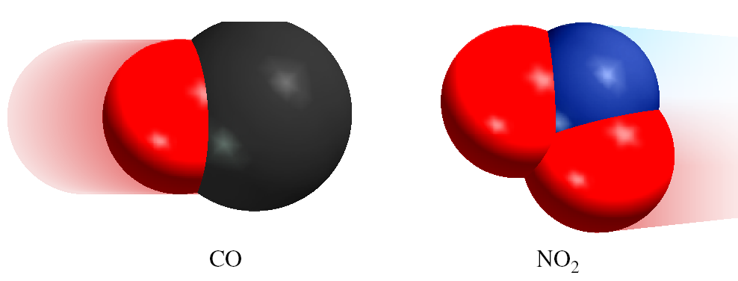
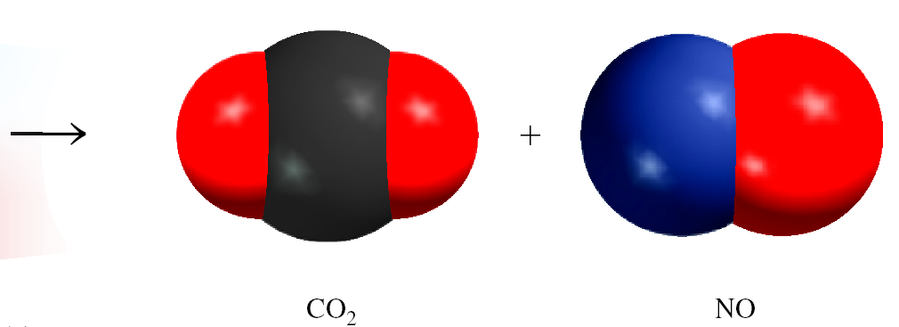
Molecular Orientation
3) Have the correct orientation to react.
Form a C-O bond!
ineffective collision
effective collision

Slide 27
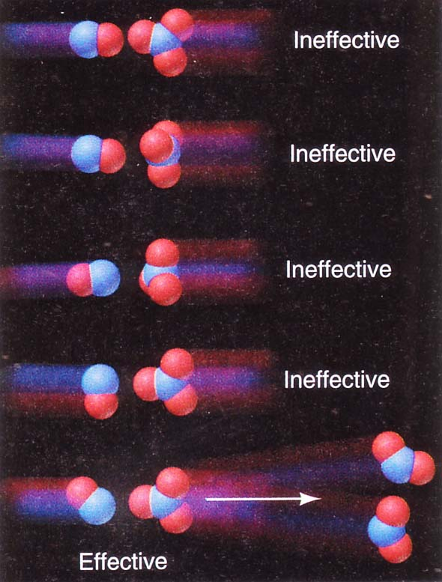
Molecular Orientation
The Arrhenius equations must be modified to:
orientation factor
1 in 6 collisions effective

Slide 28
Chapter 13
Ch 13
Page 564

Slide 29
Collision theory of reaction rates
1) Molecules Must Collide (concentration dependence)
2) Have enough energy to make and break bonds
O and O₃ collide
Bond making (releases energy)
Bond breaking (requires energy)
3) Have the correct orientation to react.

Slide 30
Collision theory of reaction rates
1) Molecules Must Collide
A + B ⎯→ 2C
2A + 2B
  4 interactions
The number of collisions is proportional to the number of molecules, that are able to collide.
This explains the concentration dependence of the rate law:
3A + 2B
  6 interactions
4A + 2B
  8 interactions
2 x [A] = 2 x collisions = 2 x rate

Slide 31
Reaction Coordinate Diagram
A + B ⎯→ 2C
Activation Energy
Need to add energy to the system
Energy is released
A + B
Thermodynamic driving force
2C
Energy of the Reactants
Energy of the Product
Progress of the reaction

Slide 32
Arrhenius Equation
E_{a}
1
ln k = -
•
+ ln A
R
T
E_{a} is the activation energy (J/mol)
R is the gas constant (8.314 J/K•mol)
T is the absolute temperature (K)
A is the frequency factor
(~collision frequency)
Temperature
Rate constant
Reaction rate
Activation energy
Rate constant
Reaction rate

Slide 33
Arrhenius Equation
Alternate Forms of the Arrhenius Equation
Slope = change in y/the change in x
or
If we know E_{a} and k₁ at one temperature we can predict k₂ at another T.

Slide 34
Molecular Orientation
The Arrhenius equations must be modified to:
orientation factor
1 in 6 collisions effective

Slide 35
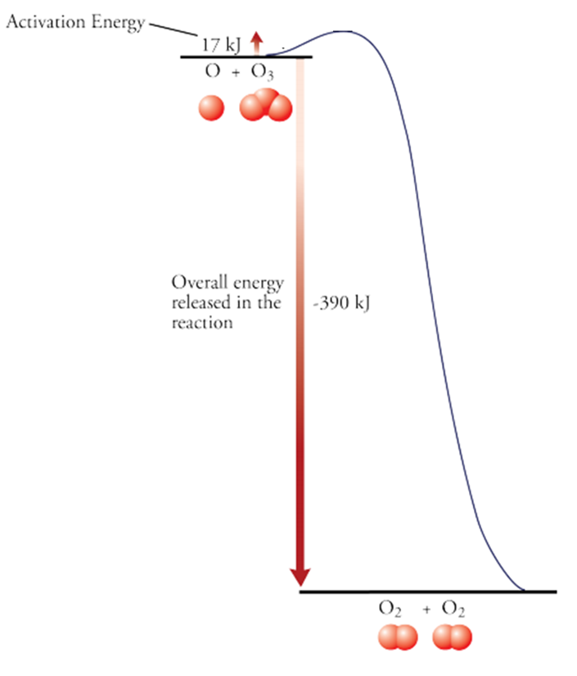
Collision theory of reaction rates
1) Molecules Must Collide (concentration dependence)
2) Have enough energy to make and break bonds
3) Have the correct orientation to react.
Start
Finish
What about everything in between?

Slide 36
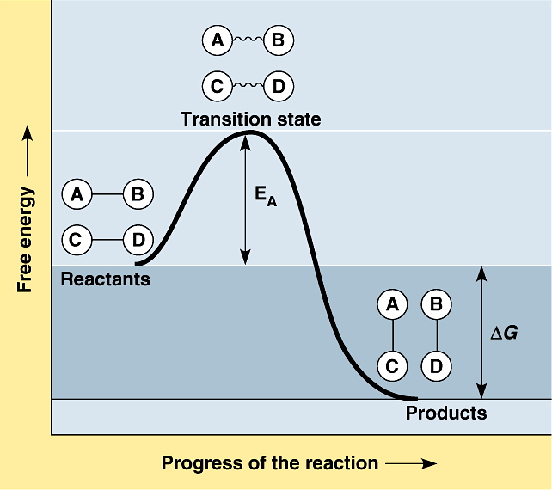
Transition State Theory
36

Slide 37
Transition State Theory
Postulate of the transition state theory:
  Reactants form a high energy intermediate,
  the transition state, which then falls apart
  into the products.
For a reaction to occur, the reactants must acquire sufficient energy to form the transition state.
  This is the activation energy of the reaction.
The transition state is neither reactant nor product, but a transitional species with partial bonds.
To reach the transition state, or activated complex, the energy of colliding particles should be equal to or greater than the activation energy.

Slide 38
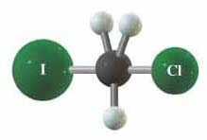
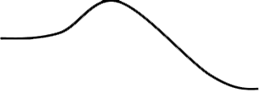
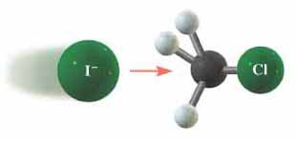
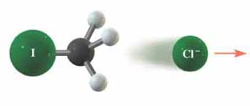
Transition State Theory
  Transition State
  E_{a}
  ΔH
  Reactants
  Products

Slide 39
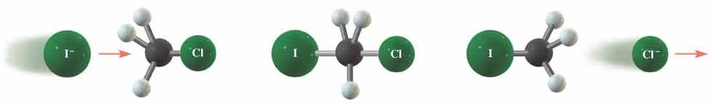
Transition State Theory
I– + CH₃Cl ⎯→ CH₃I + Cl–
  –
  Reactants
  Transition state
  Products
The transition state “cannot” be isolated, because its lifetime is very short.
For a very long time since postulating this theory, the transition state even could not be observed.
The development of the ultrafast (femtosecond) spectroscopy allows the direct study of this state.
If you understand the transition state maybe you can use it to lower the activation energy (increase rate).

Slide 40
Chapter 13
Ch 13.5
Page 596

Slide 41
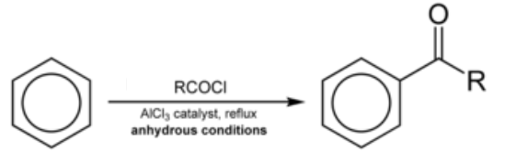
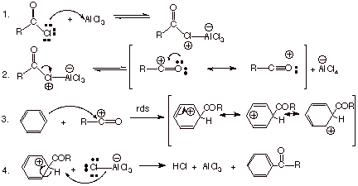
Reaction Mechanism
Reaction mechanism- step-by-step process that occurs on a molecular level as reactants change into products.
Range of syntheses from aspirin to heroin.
A + B → 2C
Ch 13.5
Page 596

Slide 42

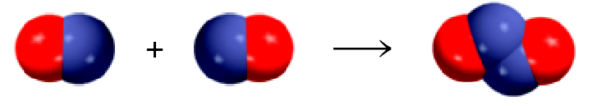

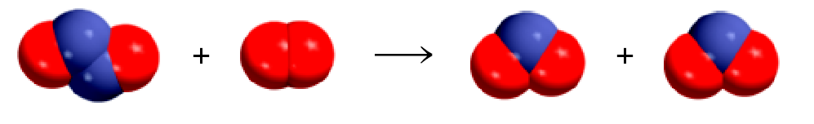
Reaction Mechanism
Overall Reaction:
2NO + O₂ 2NO₂
Before
After
Reaction Mechanism
Step 1:
Step 2:
The reaction mechanism is a sequence of elementary steps that leads to product formation.

Slide 43
Reaction Mechanism
A reaction mechanism can have one step or several steps.
Step 1:
Step 2:
Overall Reaction:
2NO + O₂ 2NO₂
N₂O₂ is an intermediate because it appears in the mechanism (elementary steps) but not in the overall reaction.
Reaction intermediates are usually unstable relative to the reactants and/or products.
They are, however far more stable than transition states.
Can be detected during the reaction!
Sometimes stable enough to be isolated.
Ch 13.5
Page 596

Slide 44
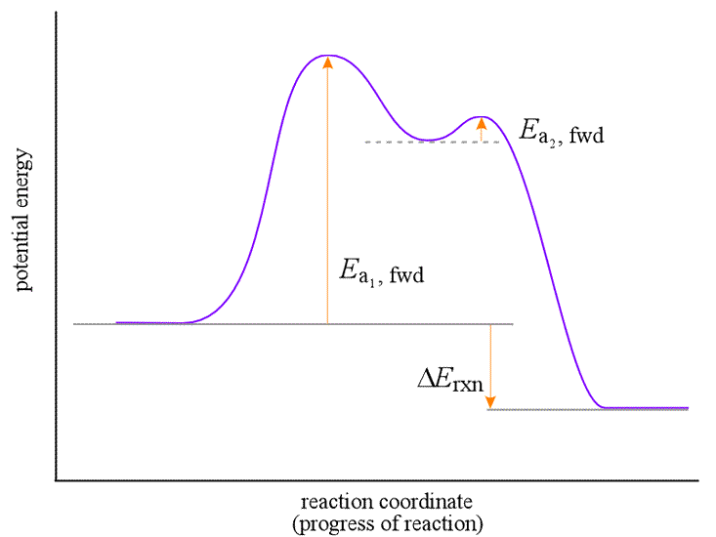
Reaction Mechanism
Step 1:
Step 2:
Overall Reaction:
2NO + O₂ 2NO₂
Each elementary step has a valley.
Reaction intermediates are usually unstable relative to the reactants and/or products.
They are, however more stable than transition states.
Sometimes stable enough to be isolated.
N₂O₂ + O₂
NO + NO + O₂
2NO₂

Slide 45
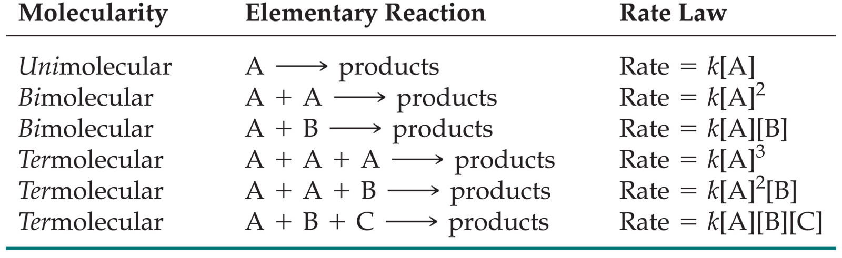
Molecularity of a Reaction
The molecularity of a reaction is the number of molecules reacting in an elementary step.
The rate law for an elementary step is written directly from that step.
Step 1:
Bimolecular
rate = k[NO]²
Step 2:
Bimolecular
rate = k[N₂O₂] [NO₂]
Overall Reaction:
2NO + O₂ 2NO₂

Slide 46
Molecularity Example
CH₄ + Cl₂ → HCl + CCl₄ + CH₃Cl…
Write down the rate laws and describe them as uni- bi- or ter-molecular steps.
Elementary reactions:
Cl₂ → 2 Cl
2 Cl → Cl₂
Cl + CH₄ → HCl + CH₃
CH₃ + Cl → CH₃Cl
CH₃ + CH₃ → CH₃-CH₃
CH₃Cl + Cl → HCl + CH₂Cl
CH₂Cl + Cl → CH₂Cl₂
* * * (and more)
Molecularity
Rate Law
unimolecular
rate = k[Cl₂]
bimolecular
rate = k[Cl]²
bimolecular
rate = k[Cl][CH₄]
Rate Law of the individual steps, not the overall reaction!
Overall rate law is dictated by the slowest step

Slide 47

Rate Determining Step
The rate determining step is the slowest step in the sequence of steps leading to product formation.
Step 1:
Step 2:
Step 3:
Overall rate = rate for slowest step
Overall rate law = rate law for the slowest step

Slide 48
Rate Determining Step
2 NO₂ + F₂ → 2 NO₂F
Proposed two-step mechanism:
i NO₂ + F₂ → NO₂F + F
ii NO₂ + F → NO₂F
rate = k [NO₂][F₂]
rate = k [NO₂][F]
Are there any intermediates in this reaction?
What are the rate laws for each step?
The overal rate law is rate = k [NO₂][F₂], what is the rate determining step?
F

Slide 49
Rate Determining Step
Proposed two-step mechanism:
i NO₂ + F₂ → NO₂F + F
ii NO₂ + F → NO₂F
Slow Step
NO₂F + F
Slower step has the highest barrier.
NO₂ + F₂
NO₂F

Slide 50

13.10
The gas-phase decomposition of nitrous oxide (N₂O) is believed to occur via two elementary steps:
Experimentally the rate law is found to be rate = k[N₂O].
Write the equation for the overall reaction.
Identify the intermediate.
What can you say about the relative rates of steps 1 and 2?
Propose a reaction coordinate diagram.

Slide 51

13.10
The gas-phase decomposition of nitrous oxide (N₂O) is believed to occur via two elementary steps:
Experimentally the rate law is found to be rate = k[N₂O].
Write the equation for the overall reaction.

Slide 52
13.10
The gas-phase decomposition of nitrous oxide (N₂O) is believed to occur via two elementary steps:
Experimentally the rate law is found to be rate = k[N₂O].
Write the equation for the overall reaction.
Identify the intermediate.
O atom is produced in the first elementary step and it does not appear in the overall balanced equation.

Slide 53
13.10
The gas-phase decomposition of nitrous oxide (N₂O) is believed to occur via two elementary steps:
Experimentally the rate law is found to be rate = k[N₂O].
Write the equation for the overall reaction.
Identify the intermediate.
What can you say about the relative rates of steps 1 and 2?
O is the intermediate
overall rate law = rate law for the rate-determining step
Therefore Step 1 is rate determining.

Slide 54
13.10
The gas-phase decomposition of nitrous oxide (N₂O) is believed to occur via two elementary steps:
Experimentally the rate law is found to be rate = k[N₂O].
Write the equation for the overall reaction.
Identify the intermediate.
What can you say about the relative rates of steps 1 and 2?
Propose a reaction coordinate diagram.
O is the intermediate
Step 1

Slide 55
13.10
The gas-phase decomposition of nitrous oxide (N₂O) is believed to occur via two elementary steps:
(d) Propose a reaction coordinate diagram.
Lets assume it is exothermic.
Intermediate is higher in energy than R and P.
Energy
N₂ + O
+ N₂O
Step 1 slow, higher E_{a}.
N₂O
N₂ + O₂
Reaction Progress

Slide 56

Tying it All Together
What is the overall reaction?
Is it exothermic or endothermic?
How many elementary steps?
Write the rate law for each step?
What is the molecularity for each step?
From highest to lowest what are the relative energies of activation?
What is the rate determining step?
What is the overall rate law?
What are the intermediates?
Propose a transition state for each step.

Slide 57




Experimental Kinetics
Design experiment to support proposal
1) Mix reactants together and monitor reaction.
-Vary concentration of reactants
-Vary temperature
2) Use data to propose a rate law.
3) Propose a reaction mechanism.
4) Design experiments to support proposal.
-Attempt to observe/isolate intermediates
-Labeling experiments
-Modify structures
5) Try to make it faster/cheaper/more efficient.

Slide 58
3) Propose a reaction mechanism
Use the concentration dependence and rate law to propose a reaction mechanism.
The proposed mechanism must meet three criteria:
  The elementary steps must add up to the overall balanced equation.
  The mechanism must correlate with the experimentally established rate law.
  The elementary steps must be physically and chemically reasonable.
  The mechanism should be as simple as possible while still agreeing with experiment.

Slide 59
Experimental Kinetics
Design experiment to support proposal
1) Mix reactants together and monitor reaction.
-Vary concentration of reactants
-Vary temperature
2) Use data to propose a rate law.
3) Propose a reaction mechanism.
4) Design experiments to support proposal.
-Attempt to observe/isolate intermediates
-Labeling experiments
-Modify structures
5) Try to make it faster/cheaper/more efficient.

Slide 60

4) Design experiments to support proposal.
-Attempt to observe/isolate intermediates.
FSO₃H
SbF₅
2CH₄
H₂C=CH₂ + 2H₂
Proposal 1:
Transition State
Proposal 2:
Transition State
Intermediate
Transition State

Slide 61


4) Design experiments to support proposal.
-Attempt to observe/isolate intermediates.
1994 Nobel Prize in chemistry
Proposal 2:
Transition State
Intermediate
Transition State

Slide 62

4) Design experiments to support proposal.
Science 2015, 347, 643-646.
http://www.sciencemag.org/content/347/6222/643.full

Slide 63

4) Design experiments to support proposal.
Science 2015, 347, 643-646.
Note: this reaction coordinate diagram does not contain activation barriers or transitions states.
Proposed intermediate

Slide 64




4) Design experiments to support proposal.
Science 2015, 347, 643-646.

Slide 65

4) Design experiments to support proposal.
Science 2015, 347, 643-646.
Why do we care?

Slide 66

4) Design experiments to support proposal.
- Labeling experiments.
Where did the oxygen come from (O or O)?

Slide 67

4) Design experiments to support proposal.
- Labeling experiments.

Slide 68
Experimental Kinetics
Design experiment to support proposal
1) Mix reactants together and monitor reaction.
-Vary concentration of reactants
-Vary temperature
2) Use data to propose a rate law.
3) Propose a reaction mechanism.
4) Design experiments to support proposal.
-Attempt to observe/isolate intermediates
-Labeling experiments
-Modify structures
5) Try to make it faster/cheaper/more efficient.

Slide 69
Chapter 13
Ch 13
Page 564

Slide 70
Catalysis
Catalyst is a substance that increases the rate of a chemical reaction without being consumed.
  Takes part in the reaction (interacts with the reactants).
  Lowers activation energy by changing the mechanism by which the process occurs.
  After the interaction it returns to its original state (is not consumed).
  Speeds up both the forward and the reverse reactions.
  Does not increase the yield of the product, but gets to the product more quickly.

Slide 71


Catalysis
Uncatalyzed
Catalyzed
  ΔE and overall reaction are the same.
  Catalyst lowers E_{a}.
E_{a}
k

Slide 72

Catalysis Example
  ΔE and overall reaction are the same.
  Catalyst lowers E_{a}.
  Catalyst not consumed.

Slide 73
Importance of Catalysis
  Life on earth
  Catalysts (enzyme) participates most part of life cycle
  e.g. growth, maintenance, decaying
  Converting sun light into various other forms of energies
  e.g. photosynthesis CO₂ + H₂O -> H_{x}C_{y} + O₂
  Catalysis plays a key role in our environment
  Chemical Industry
  ca. $2 bn annual sale of catalysts
  ca. $200 bn annual sale of the chemicals that are related products
  90% of chemical industry has catalysis-related processes
  Catalysts contributes 2% of total investment in a chemical process

Slide 74
Types of Catalysis
Fine chemicals
Basic
chemicals
Health
Homogeneous
catalysis
Photo-
catalysis
Bio-
catalysis
Molecular
biology
New
materials
Catalysis
Electro-
catalysis
Heterogeneous
catalysis
Food
Environmental
technologies
Energy

Slide 75



Homogeneous vs. Heterogeneous
Zeolite catalyst
Catalyst powders
Homogeneous catalysis
Single phase
(Typically liquid)
Low temperature
Heterogeneous catalysis
Multiphase
(Mostly solid-liquid and solid-gas)
High temperature

Slide 76


Homogeneous Catalysis
• catalyst and reactants are in the same phase (usually liquid)
• reaction proceeds through an intermediate species with lower energy
• there is usually more than one reaction step
Advantages of homogeneous catalysis:
1. Easier to study
2. High selectivity
3. Ease of heat dissipation from exothermic reactions
Disadvantages of homogeneous catalysis:
1. Scale-up can be costly, difficult, and dangerous
2. Separation is required

Slide 77

Homogeneous Catalysis: Ozone
Ozone layer- region of Earth's stratosphere that that contains high concentrations of ozone(O₃) and absorbs most of the Sun's UV radiation.
Gas-Gas Reaction
Atmospheric OZONE Equilibrium O₃ → O• + O₂
CFCs- chlorofluorocarbons CCl₄, CCl₂F₂, CCl₃F…
Reaction process:
CFC's break down in UV light CCl₃F → Cl• + •CCl₂F
chlorine radicals then react with ozone O₃ + Cl• → ClO• + O₂
chlorine radicals are regenerated ClO• + O → O₂ + Cl•
CFC's are a catalyst.
O₃ → O• + O₂

Slide 78

Homogeneous Catalysis: Ozone
1950s-70s CFCs wide spread use in refrigerators.
1960s and 70s scientists observe a depletion in the ozone layer.
Mid 70s scientists propose a catalytic mechanism for the
CCl₂F₂ → Cl• + •CClF₂
O₃ + Cl• → ClO• + O₂
ClO• + O → O₂ + Cl•
1996- CFC production ends in US and Europe
2010-for the first time in decades the ozone concentration is increasing

Slide 79



Homogeneous Catalysis: Enzymes
Enzymes-are biological molecules (proteins) that act as catalysts.
-homogeneous catalysts, reacting in solution (within cells, etc.)
“lock and key” mechanism- molecule specific active site.
A + A → B
Step 1 Step 2 Step 3
A Only species with the correct shape can enter the active site in the enzyme
B Once in position, the substrate can react with a lower activation energy
C The new product is released

Slide 80





Homogeneous Catalysis: Enzymes
A → B + C
Binding of Glucose to Hexokinase

Slide 81

Homogeneous Catalysis: Enzymes
The “Gold Standard” of catalysts
Highly specific
Highly selective
Highly efficient
Catalyze very difficult reactions
  N₂ → NH₃
  CO₂ + H₂O → C₆H₁₂O₆
“Small scale” reaction
Triosephosphateisomerase
“TIM”
Cytochrome C Oxidase
Highly tailored “active sites”
Often contain metal atoms

Slide 82
Homogeneous vs. Heterogeneous
Zeolite catalyst
Catalyst powders
Homogeneous catalysis
Single phase
(Typically liquid)
Low temperature
Heterogeneous catalysis
Multiphase
(Mostly solid-liquid and solid-gas)
High temperature

Slide 83

Heterogeneous Catalysis
Catalytic Hydrogenation of Alkenes
Liquid/Gas
Reactants
Products
Solid Catalyst
Surface
Nanoparticle
Zeolite
H₂C=CH₂ + 2H₂
C₂H₆

Slide 84




High Surface Area
Solid phase material
Porous on the scale of molecular dimensions
  10 – 100 Å
  Up to 1000’s m²/g surface area
Catalysis through
  shape selection
  acidity/basicity
  incorporation of metal particles
10 Å
100 Å
Zeolite (silica-aluminate)
MCM-41 (mesoporous silica)
Silico-titanate

Slide 85

Important Heterogeneous Reactions
Fischer-Tropsch chemistry
  CO + H₂ → (CH₂)_{n} + H₂O , syn gas to liquid fuels
  Fe/Co catalysts
  Source of fuel for Axis in WWII
Fluidized catalytic cracking
  High MW petroleum → low MW fuels, like gasoline
  Zeolite catalysts, high temperature combustor
  In your fuel tank!
Haber-Bosch process
  N₂ + H₂ → NH₃
Automotive three-way catalysis
  NO_{x}/CO/HC → N₂/H₂O/CO₂/H₂O

Slide 86
Important Heterogeneous Reactions
Fritz Haber (1905)
Carl Bosch(1909)
  80g/hour
Commercialization (1913)
  20 metric tons/day
Haber - Bosch Process (Today)
  >100,000,000 metric tons/year
“Arguably the highest impact innovations of the twentieth century:
without it, 50% of the world’s population would not be here.”
Smil, V. Nature 1999, 400, 415.
Notes:
80 g = less than a ¼ lb

Slide 87

Important Heterogeneous Reactions
N₂ + 3H₂ 2NH₃
Uncatalyzed
Catalyzed

Slide 88




Important Heterogeneous Reactions
Haber-Bosch Reaction
150 atm
400-600 °C
Fe/Al₂O₃
N₂ (g) + 3H₂ (g) 2NH₃ (g)
catalyst
Fritz Haber
1918 Nobel Prize in Chemistry

Slide 89



Important Heterogeneous Reactions
Does not always go to completion. Also exhausts NO, CO, C_{x}H_{y}.

Slide 90


Important Heterogeneous Reactions
“Three-way” Catalyst
CO → CO₂
HC → CO₂ + H₂O
NO_{x} → N₂
Monolith reactor
Most widely deployed heterogeneous catalyst in the world!
Pt, Rh, Pd
Alumina, ceria, lanthana, …

Slide 91
Types of Catalysis
Fine chemicals
Basic
chemicals
Health
Homogeneous
catalysis
Photo-
catalysis
Bio-
catalysis
Molecular
biology
New
materials
Catalysis
Electro-
catalysis
Heterogeneous
catalysis
Food
Environmental
technologies
Energy

Slide 92

Battles still to be won
Future Nobel Prizes:
Make these reactions faster/cheaper/more efficient/room temperature-pressure
Selective C-H Activation

Slide 93
Chapter 13
Ch 13
Page 564

